Slide 1
Tell Me About My Ancestors: A Study of Collaborative Information Production on Ancestry.com
Heather Willever-Farr
College of Information Science and Technology
Drexel University
Notes:
Throughout this presentation I will use the term genealogist to denote anyone doing any kind of family history research.

Slide 2
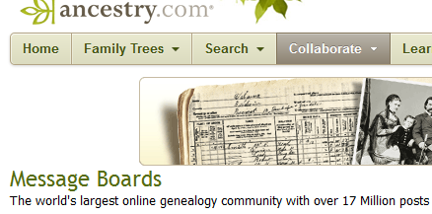
Family History Researchers’ Information Production
Consumers and producers
Informal information production
Formal information production

Slide 3
Family History Q&A Forums
Widespread use of family history Q&A forums
Little known about user interactions in these forums
Notes:
To support the large numbers of genealogists who are online, web-based Question and Answers forums have cropped up for those who are seeking and sharing family history information. While the use of genealogy Q&A forums is wide-spread, relatively little is known about the interactions among users of these forums.

Slide 4
What We Know About the Interactions of Family History Researchers (FHRs)
Information sharing community (Duff & Johnson, 2003; Yakel &Torres, 2007; Fulton, 2009)
Face-to-face interactions: experienced FHRs assist others by providing instructional help, such as “teaching them to interpret records, instructing them in search strategies and processes, and passing on other forms of both explicit and tacit knowledge” (Yakel &Torres, 2007)
Virtual interactions: inchoate picture
Web provides a means for FHRs to connect with weak ties (Fulton, 2009)
FHR newsgroups are virtual communities (Veale, 2004)
Notes:
Research on genealogists’ information behaviors leaves an inchoate picture of their online interactions. Fulton contributes the most to our understanding of these interactions. In her qualitative study of genealogists, she found that the web provides a means for genealogists to connect with family and fellow genealogists that went beyond the genealogists’ immediate circles. There is much room to learn more about the online world of genealogists.

Slide 5
What We Know About Users of Q&A Forums
Data drawn from large multipurpose Q&A websites
Conducted with an eye to automatic retrieval
Two types of users: users who ask questions and users who answer questions (e.g. Shah, et al., 2008)
A small group of answerers disproportionately answer a large share of the questions (e.g. Zhang, et al., 2007)
These studies “have not yet unpacked the black box of the processes that characterize Q&A sites” and have not examined these sites “in the context of larger societal or even industry trends” (Rosenbaum & Shachaf, 2009)
Micro collaboration (Gazen, 2010)
Notes:
Yahoo! Answers and Answerbag

Slide 6
Research Questions
What kinds of social interactions emerge among askers and answerers on a message board for family history researchers (FHRs)?
In what ways does the mediated environment influence those interactions?
Are Q&A forums serving as a means to educate users about the practices of the FHR community?

Slide 7
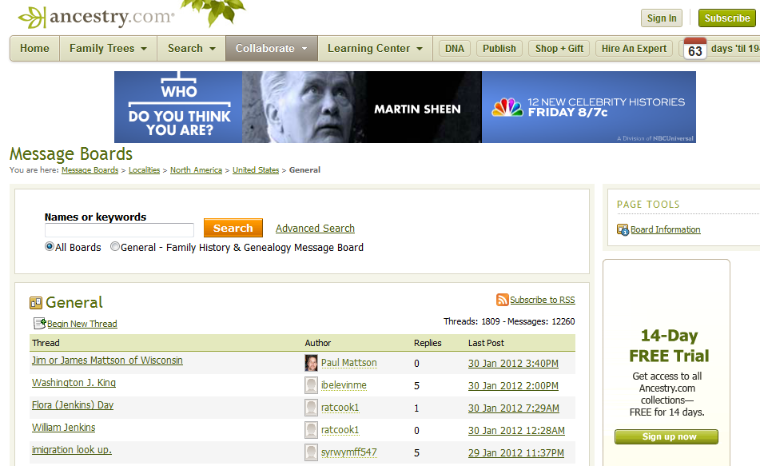

Slide 8
Method
All posts from Jan. 2010- Dec. 2010 analyzed (total: 1,087 posts)
Content and thread analyses
200 posts categorized using categories drawn from existing Q&A typologies
Posts were divided into asker and answerer posts
Iterative process -- additional categories identified and categories that did not adequately represent posts replaced
Factual answers were also examined to determine, if possible, the source of the data
Descriptive statistics generated (SPSS)
Notes:
Harper, F.M., Weinberg, J., Logie, J., and, Konstan, J.A. 2010.Question types in social Q&&A sites. First Monday, 15, 7.
SPSS software
The only way that some of the categories emerged was because we explored the role or the purpose posts played in the exchange between asker and answer. This goes to unpacking the social interactions that are occurring on Q&A message boards.

Slide 9
Asker Posts
Factual Question
Instruct Question
Source Question
Request for Family Contact Question
Unclear Question
Gratitude
Elaboration
Notes:
Harper, F.M., Weinberg, J., Logie, J., and, Konstan, J.A. 2010.Question types in social Q&&A sites.First Monday, 15, 7.
SPSS software

Slide 10
Asker Posts
“Can anybody give me any information about the above who I believe may have moved to the United States…I don't have Ancestry Worldwide so can't search the records for the US.”
Factual Question
Request for genealogical factual data from sources, such as census, birth, death, or marriage records

Slide 11
Asker Posts
“Many thanks for the link to the US National Archives. It is a maze of info, and I am not sure how to use?”
“So how do I go about reconstructing his visit to the US?”
Instruct Question
Asking for instruction on how to conduct some aspect of genealogical research, such as how to conduct successful searches in online databases.

Slide 12
Asker Posts
“Where can I get naturalization records?”
Source Question
Asking where specific information is located.
Notes:
Harper, F.M., Weinberg, J., Logie, J., and, Konstan, J.A. 2010.Question types in social Q&&A sites.First Monday, 15, 7.
SPSS software

Slide 13
Asker Posts
“If you are descendants of de van Brederode I want to ask you if you want to contact me?”
Request for Family Contact
Requesting living relatives to contact them.
Notes:
Harper, F.M., Weinberg, J., Logie, J., and, Konstan, J.A. 2010.Question types in social Q&&A sites.First Monday, 15, 7.
SPSS software

Slide 14
Asker Posts
Unclear Question
Purpose of the question is unclear. Often data given without clear request.
“Hi, I am researching my great-grandmother Annie, who was born 1870 in Yorkshire, England.”
Notes:
Harper, F.M., Weinberg, J., Logie, J., and, Konstan, J.A. 2010.Question types in social Q&&A sites.First Monday, 15, 7.
SPSS software

Slide 15
Asker Posts
“Thanks so much!!”
Gratitude
Asker thanking answerers for their help and the information provided.
Notes:
Harper, F.M., Weinberg, J., Logie, J., and, Konstan, J.A. 2010.Question types in social Q&&A sites.First Monday, 15, 7.
SPSS software

Slide 16
Asker Posts
“My Johnson came from Sweden and was born 1855.”
Elaboration
Asker offering additional information to aid the answerer in their search; often offered in response to answerer’s request for additional information/data.
Notes:
Harper, F.M., Weinberg, J., Logie, J., and, Konstan, J.A. 2010.Question types in social Q&&A sites.First Monday, 15, 7.
SPSS software

Slide 17
Answerer Posts
Factual Answer
Instruct Answer
Source Answer
Family Connection Answer
Probes
Opinions
Encouragement
Notes:
Harper, F.M., Weinberg, J., Logie, J., and, Konstan, J.A. 2010.Question types in social Q&&A sites.First Monday, 15, 7.
SPSS software

Slide 18
Answerer Posts
“Name: Harriet Chance Arrival Date: 29 Nov 1917 Age: 34 Birth Date: abt 1883.”
Factual Answer
Factual data drawn from existing sources such as census, military, or marriage records.
Notes:
Harper, F.M., Weinberg, J., Logie, J., and, Konstan, J.A. 2010.Question types in social Q&&A sites.First Monday, 15, 7.
SPSS software

Slide 19
Answerer Posts
Instruct Answer
Instructions on how to conduct genealogical research, such as how to interpret historical records or how to conduct successful searches
“If she was adopted, it's likely she would have had some biological relationship with the family. I would examine all the baptism records of her children, and all her (supposed) siblings, noting the godparents. You might find the answer to your puzzle in the records of the extended family.”
Notes:
Harper, F.M., Weinberg, J., Logie, J., and, Konstan, J.A. 2010.Question types in social Q&&A sites.First Monday, 15, 7.
SPSS software

Slide 20
Answerer Posts
“check the Ellis Island site for immigration records - http://www.ellisisland.org”
“Edmund was my step-grandfather…”
Source Answer
Referring asker to a particular source.
Family Connect Answer
Answerers suggesting that they are related to the askers.
Notes:
Harper, F.M., Weinberg, J., Logie, J., and, Konstan, J.A. 2010.Question types in social Q&&A sites.First Monday, 15, 7.
SPSS software

Slide 21
Answerer Posts
“Do you have clues as to Ida or her family which might help in a search? Birth date? Date of emigration?”
Probe
Answerers requesting more information from the askers to help them conduct research for askers.
Notes:
Harper, F.M., Weinberg, J., Logie, J., and, Konstan, J.A. 2010.Question types in social Q&&A sites.First Monday, 15, 7.
SPSS software

Slide 22
Answerer Posts
“Good luck in your search!”
Encouragement
Offering encouragement to the asker as they go forward in their research.
Notes:
Harper, F.M., Weinberg, J., Logie, J., and, Konstan, J.A. 2010.Question types in social Q&&A sites.First Monday, 15, 7.
SPSS software

Slide 23
Findings: Asker Posts
N=490 asker posts
Notes:
30% factual genealogical data about specific families
3% how to do genealogical research (instruct)
1.7% requests for unknown living relatives to contact the asker
0.9% source questions (e.g. what website has marriage records?)
4.2% unclear questions
32.8% gratitude
27.4 % elaboration posts

Slide 24
Findings: Answerer Posts
N=597 answerer posts
Notes:
Factual answers were the most frequently provided type of content (58%), followed by requests for more detail from the asker (probes) (11.2%), instruct answers (11.2%), and source answers (10.7%). Answers that suggested a familial connection (4.4%), offered opinions (3.7%), or provided encouragement (.8%) were far less common.

Slide 25
Findings: Askers by Content Type
N=177 askers
Notes:
77.2% were looking for factual information about families
followed by 8.8% who posted unclear questions
6.8% who posted instruct questions
4.8% who posted source questions
2.4% who made family contact requests
Of the 177 askers, 41.8% posted elaboration responses when answerers asked for more detailed information
Over forty percent (40.6%) of the askers thanked their answerers.

Slide 26
Findings: Answerers by Content Type
N=124 answerers

Slide 27
Findings: Collaboration
Collaborative research, not collaborative instruction
83.6% of the message board threads revealed collaborative work among a group of answerers
On average 3.12 answerers attended to a question
Probes and elaboration also suggest collaboration between askers and answerers

Slide 28
Findings: “Super Sharers”

Slide 29
Findings: Super sharers
Of the super sharers, 66.6% used probes, while only 18.3% of the other 112 answerers used probes to gather more data from the askers
Super sharers were three times as likely to post instructional answers than other answerers
Half of the super sharers sometimes offered instruction even when family data was requested

Slide 30
Discussion
Web environment, interactive technologies, and online data make the emphasis on data provision feasible
Data provision, little instruction
Expectations of users of Q&A forums – implications for archives
Q&A forums - participatory platforms that enable collaboration among users
Notes:
Immediacy of the web – expectation that answers can be had easily because they are out there on the web. Yes, not that difficult to find if you know how to search online databases successfully. 1000’s of records for the same surnames in online databases such as those on Ancestry.com. Seasoned genealogists know they need more than a name, they need contextual information, in order to locate right data for the right person. Hence the need for probes and asker elaboration. In providing data, answers are not providing any detail about the “how-to’s” in searching for family data on the web. However, probes may provide an avenue for learning by informing the asker that it is impossible to find the right information for the right person without having some data about the individual or the larger family unit.

Slide 31
Implications for Participatory Archival Practice
Super sharers appear to be experts who could share their knowledge with archives patrons
Supporting patrons as producers means providing space for patrons to engage in collaborative reference and other forms of informal information production

Slide 32
Questions?
Heather Willever-Farr
hlw29@drexel.edu

Slide 33
Selected References
Duff, W. M. & Johnson, C. A. (2003). Where is the list with all the names? Information-seeking behavior of genealogists. American Archivist, 66, 79-95.
Flinn, A. (2010). An attack on professionalism and scholarship?: Democratising archives and the production of knowledge. Adriadne, 72.
Fulton, C. 2009. Quid pro quo: Information sharing in leisure activities. Library Trends, 57, 752-768
Hong, L. & Davison, B. D. (2009). A classification-based approach to question answering in discussion board. In Proceedings of ACM SIGIR conference on Research and development in information retrieval (pp. 171-178.). New York, NY: ACM.
Huvila, I. (2008). Participatory archive: towards decentralised curation, radical user orientation, and broader contextualization of records management. Archival Science, 8, 15-36.
Shachaf, P. & Rosenbaum, H. (2009). Online social reference: A research agenda through a STIN framework. In proceedings of the iConference ’09. New York, NY: ACM.
Shah, C., Oh, J.S., & Oh, S. (2008). Exploring characteristics and effects of user participation in online social Q&A sites. First Monday, 13, 9.
Veale, K. (2004). Discussing our family trees: Finding community-based communication in genealogical newsgroups. Journal of Education, Community and Values: Interface on the Internet, 4(4).
Yakel, E. & Torres, D.A. (2007). Genealogists as a “community of records.” American Archivist, 70, 93-113.
Welser, H.T., Gleave, E., Fisher, D., & Smith, M. (2007). Visualizing the signatures of social roles in online discussion groups. Journal of Social Structure, 8(2), 1-32.
Zhang, J., Ackerman, M. S., & Adamic, L. (2007). Expertise networks in online communities: structure and algorithms. In Proceedings of the 16thinternational conference on World Wide Web (pp. 221-230). New York, NY: ACM.
Notes:
Harper, F.M., Weinberg, J., Logie, J., and, Konstan, J.A. 2010.Question types in social Q&&A sites.First Monday, 15, 7.
SPSS software

